Slide 1




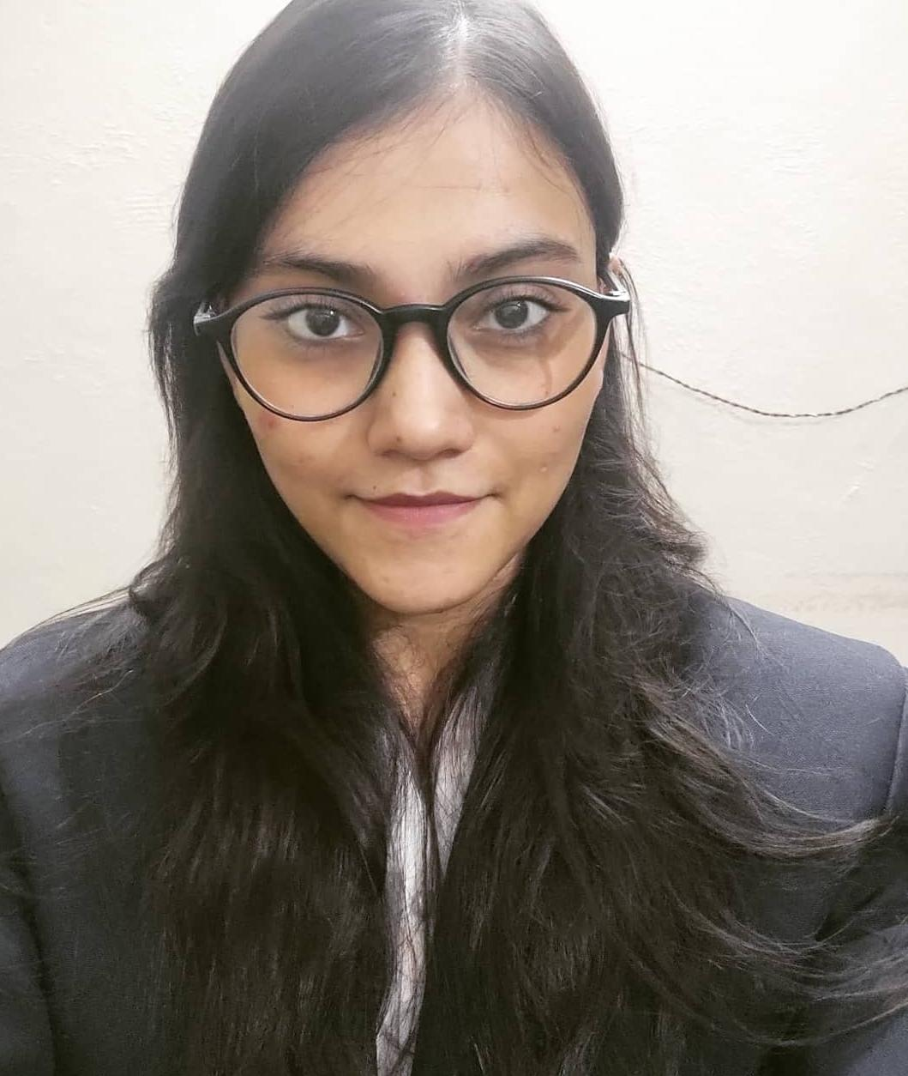
Team SORTED
CONSULTING CZARS 2023
ROUND 3
Devesh Sinha Mohit Kiradoo Kajal Gupta
T. A. Pai Management Institute

Slide 2






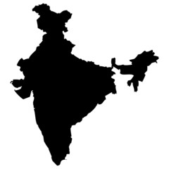








Market Scenario
About Hades
Environment Analysis
Revenue Streams
Potential Threats
Bicycle Industry in India
Segment Trend in India
India is the 2nd
Largest bicycle producer in the world
15.5 Million Bicycles produced per year with a value of $1.5 Billion
Ludhiana is the major hub for bicycle manufacturing
Kids cycles
Premium cycles
Roadster bikes
E-Bikes
E- Bikes in India
Highly fragmented market with 93-97 % domestic demand and 5-7 % exports
Being a hybrid solution of motor and pedal power and an increased inclination of people to buy e-bikes shall further drive its growth
Large demand for E-bicycles particularly for the western markets are being encouraged by government policies
India can cater to this global boom aided by export incentives spurring investment
The market employees around 1 million people
COVID-19 Impact
The pandemic induced constrains on fitness and leisure options increased the demand of bicycles by 20 percent during the covid times majorly in the kids and premium segment
Assessing the Market Potential
~3x increase in Market size
Market Size: $3.5 Bn
Exports: 15-20%
Revenue and Profitability trend for manufacturers
Market Size: $1.3 Bn
Exports: 5-7%
30%
10%
Rise in gig economy jobs
5%
30%
Thrust on indigenization and exports
55%
Sustainable Future
60%
Fitness & Lifestyle
10%
(FY2019)
E-Bikes
Kids
Premium
Roadster
(FY2030)

Slide 3




Market Scenario
About Hades
Environment Analysis
Revenue Streams
Potential Threats
About The Company
Key Offerings
Founded by Rick Riordon in Olympus sin 1956, Hades focuses on robustness and maximum value-for-money offerings. Market leader in India, with an annual manufacturing capacity of over 7.5 million cycles and a market share of more than 43%.
Hades Cycles has also contributed to India's transition to self-sufficiency with the creation of the 380-acre Hades Industrial Park in Olympus. It has captured the hearts and minds of the domestic population with modern designs, limited-edition Hades Sprint Experience Stores, appealing EMI plans, accessories, and routine maintenance.
Hades cycles was a zero-net debt company with cash reserves of over Rs 10 billion till 2020.It acquired Fireflies Bikes Pvt Ltd in 2015 in an all-cash transaction with exclusive distribution rights of ‘Trek’. They also acquired Aphrodite Sports and CNS as they expanded into the European market
Cycles for all age groups and unique cycle variants for kids, males and females
Newly ventured into the e-cycle category
It caters to the Indian clientele that prefers high-end cycles, as the main focus is on creating premium quality
It uses an Aluminum frame to make it faster, lighter and easier to maneuver as compared to conventional bikes, but it might not be the most environment friendly
Product
Place
Hades offers bicycles in multiple categories such as Mountain Bikes, Cyclocross Bike, Road Cycling Bike Limited Menu.
Some of Hades’s most popular cycles are- Hades Storm, Hades Sprint, Hades SH5, Hades Big Daddy and Hades Lectro E-bicycles.
Hades is a market leader in India with 43% market share. It places its products On its personal website, on e-commerce website and offline stores as well.
It also exports its cycle in different parts of the country.
HADES
Price
Promotion
Cycle prices range from Rs 3000-9000 in the moderate cost segment to more than Rs 1 lakh in the Super premium segment
Hades do it promotions mostly in offline stores, also recently they have launched multiple marketing campaigns as well to increase awareness amongst the customers

Slide 4
Market Scenario
About Hades
Environment Analysis
Revenue Streams
Potential Threats
Strengths:
Good customer base with 43% market share
Strong brand Image
Hades focuses on robustness and maximum value-for-money offerings.
It has exclusive distribution rights of ‘Trek’
Provides great quality product and is high on innovation
Weaknesses:
Decline in market share due to various changes happening in the company
Unable to full fill the demand of the product in some regions
Competitor Analysis
Competitor | Features | Products | Segment
Medusa Bicycles | Economical price | Medusa Cross 24T, Medusa Flavor 20T etc | Low-cost segment
Zeus | Toughness and durability | Zeus Roadeo NFS 29t, Zeus Flunk, etc | Low-cost segment
Poseidon | Excellent quality, economical price | Poseidon Gamer NV, Poseidon Senapati etc | Low-cost segment
HADES
Threats :
High competition in the industry
Competitors catering more market share by taking hold of the mid-price range customer base
Exclusion of e-bicycle segment from two major initiatives by Central Government which it has introduced FAME-II and Production linked incentive (PLI) scheme risking a loss of 10,000 crore worth of e-bicycle export order to the European union over next 5 years
Opportunities:
Right time for expanding existing capacities
Venturing into the e-bikes market as it has a huge growth potential
Capturing the bike leasing market to lease the bikes to rental companies
Introducing AI based tools attached to the bikes, to provide users with a better customer experience
Opportunities to increase profits
Customization
Bike Sharing
IoT services
Exclusive Trek distribution rights
Leasing Model
Classic sales model
Customer Group Alignment

Slide 5
Market Scenario
About Hades
Environment Analysis
Revenue Streams
Potential Threats
Classic Sales Model
Customization
Value Proposition
Ensuring the functionality of electric bicycle
Cost savings in comparison to new component
Remanufacturing as an ecological sales argument
Value Proposition
Individualization of remanufactured components
Key Activities
Platform for exchange of ideas
Analysis and evaluation of ideas
Key Activities
Remanufacturing of components
Reverse logistics and take-back of cores
Upgrades/additive retrofitting
Customer segments
B2C
Customers as source of ideas for new innovations
Channels
Electric bicycle manufacturers
Workshops and wholesalers
Reverse logistics
Key Resources
Infrastructure, facilities and equipment for production
Personnel qualification
Storage space for used parts
Key Partners
Logistics provider for reverse logistics
Suppliers of new components
Third party service providers for spare parts production and delivery
Channels
Digital platform for information exchange
Cost Structure
Development cost for the platform
Operating costs for the platform
Incentivizing new design ideas; events
Cost Structure
Sales revenue from remanufactured components
Reduction of disposal costs
Increased market share through new offerings
Sales revenue from remanufactured components
Sale of spare parts
Revenue Stream
Revenue Stream
Increased market share through new offerings on remanufactured components
Reduction of disposal costs, through remanufacturing of accumulators
Reduction of innovation costs and market research
Monetization/sales of CAD data
Remanufacturing of components will enables a circular business model, generating additional revenues through spare parts and components
Customization of bicycle or its components would incur higher cost to customer, hence this model is feasible applied to limited edition of bicycles to reduce production complexity

Slide 6
Market Scenario
About Hades
Environment Analysis
Revenue Streams
Potential Threats
Leasing Model
Bike Sharing
Value Proposition
Use-Oriented and service dominant business model
Leasing, that includes maintenance, insurance, repair, remanufacturing and disposal
Value Proposition
Flexible, demand oriented use
Regular maintenance, repair of damage and remanufacturing of components
Product period take back and upgrade
Key Activities
Leasing of electric bicycles
Customer support
Establishment and maintenance of strategic partners
Repair, remanufacturing and disposal of electric bicycles
Key Activities
Rental of fully functional and charged electric bicycles
Establishment of strategic partnership
Channels
Stationary or online dealers who offer leasing
Special providers for company bicycle leasing or for leasing with all round service of electric bicycles are often available online
Customer segments
Particularly attractive too lower income consumers who do not want to commit the financial obligation of leasing contract
Key Resources
Electric bicycle fleet
Technical infrastructure (app, website)
Key Partners
Manufacturers of electric bicycles
Workshops, which ensure repair and remanufacturing
Stationary or online bicycle dealers
Channels
Sharing apps
Offline visibility of the electric vehicles for customer awareness
Cost Structure
Production cost for electric bicycles
Running cost : maintenance, repair, remanufacturing, disposal, cost for office buildings, transport cost, personnel cost for leasing contracts.
Cost Structure
High acquisition cost for the bicycle fleet
Monthly or annual payments by the customers
Revenue Stream
Revenue Stream
Access of the data on the use, maintenance and repair of the bicycles through status monitoring
Leasing for customers to obtain a high priced electric bicycle with the latest technology at a lower acquisition cost
Payment by customers per use (Per minute/Kilometre)
Leasing of bicycles will reduces the financial pressure on the lessee and provides the lessor with a stable flow of liquidity on a monthly or annual basis, thus generating additional revenue
In this B2C bike-sharing business models, electric bicycles will be made available to customers via free-floating or docking stations to make it available to the target customers

Slide 7









Market Scenario
About Hades
Environment Analysis
Revenue Streams
Potential Threats
Emerging Mobility
Leveraging the distribution rights of Trek
1
Infrastructure: While EV adoption rates in the country are observed to have a substantial increase over the past couple of years, however availability of battery or charging infrastructure has not been able to meet the demand. Hades can look forward to provide charging stations, battery and allied services through collaborations with other organizations, government and even standalone centres
Using the vast and penetrated network of Fireflies Ltd for extended reach to the international market and increasing their exports, emerging as a new full-range supplier in the European e-bike market
Charging Stations
Battery and allied services
2
IoT/Embedded Technology based services: With increase in smartphones and hence smartwatches, and individuals getting more active about personal health and fitness, these technologies can be leveraged to provide additional wellbeing services to the consumers. Also, technologies enabling theft protection, insurance and data sharing services could be incorporated to increase revenue streams
After sales service of accessories and spare parts, and other MRO activities, will deepen income pockets and hence expand revenue streams
Wellbeing Services
Theft Protection
Insurance services
Data sharing services
Since, Trek is majorly into mountain cycling, leveraging its value proposition to conduct events and programs by collaborating with adventure organizations or fitness clubs like Cult Fit, promoting activities and increasing first hand experience of the product
Revenue from Patented Designs/Components
Analyze customer feedback to apply for patents for design, which provide consumers aspects or features serving their primary purpose
Apply for patent of components which have been observed to provide optimum performance
Use these patents for IPR, and collaborate with other OEMs for meeting their production purposes

Slide 8
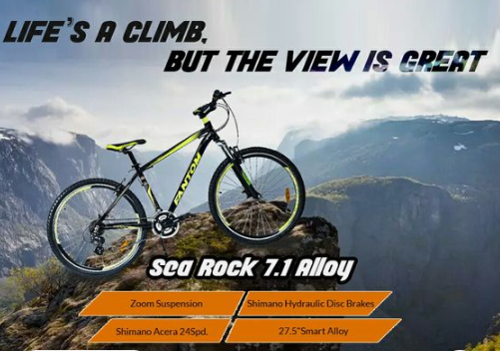
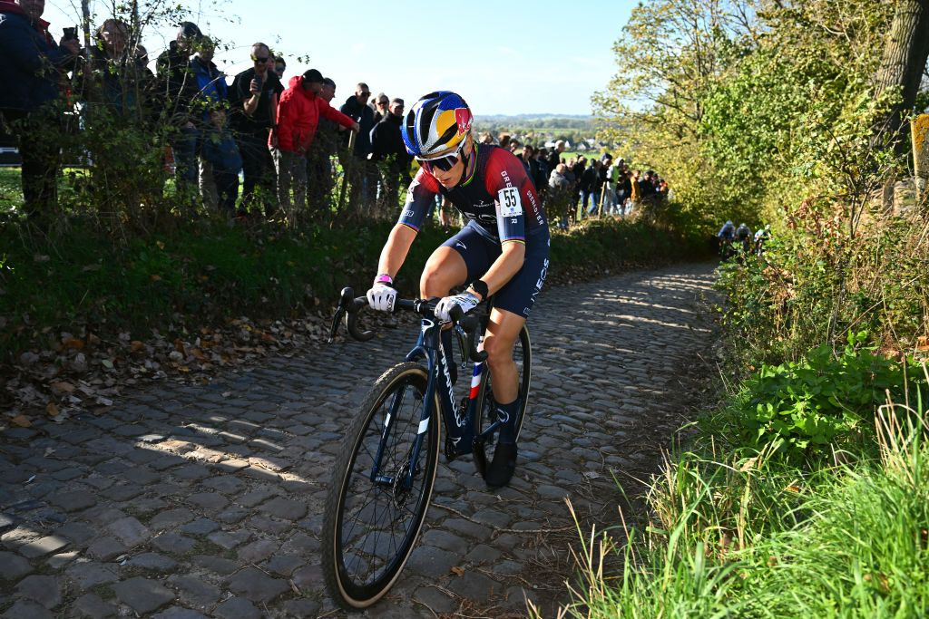


Market Scenario
About Hades
Environment Analysis
Revenue Streams
Potential Threats
Customer Group alignment
The market campaigns should be done in alignment with the target customer group, with the specific bicycle type and value proposition in place. It should cater to both men as well as women
Mountain Bikes
Cyclocross Bikes
Value proposition : Comfort, design and reliability
Target customer : Mountain bikers
Key activities : To travel off road in rough and unfavorable surfaces and for mountain biking
Campaign : The campaigning of the product should be done in such a way that it shows the over all design of the product, the comfort it provides and the safety and reliability that the bike offers
Value proposition : Design , Safety , Weight to sturdiness ratio and accessories
Target customer : People who like to go for mountain rides occasionally and like using bicycles for regular use as well
Key activities : Cyclocross bikes are a hybrid of road and mountain biking, these could be used in regular as well as for off road travels
Campaign : The campaign should highlight cyclocross bike as a hybrid bike, which provides a wholesome experience and is designed in such a way that it provides style, speed and safety
Electric Bikes
Value proposition : Ease of use, fast and flexible
Target customer : The recreational rider, The student rider, The commuting worker, The urban rider
Key activities : In providing product delivery to the customer faster for college purposes and running household errands, for recreational activities as well
Campaign : The campaign should focus on the ease of use of the bike and the multipurpose use of the product. Also it can focus of the positive impact it is making on the environment
Road Cycling Bikes
Value proposition : Affordable, safe and comfort
Target customer : Regular men/women
Key activities : For regular work ,for family activities
Campaign : The campaign should focus on the affordability, comfort and the extensive usefulness of the product
Having marketing campaigns by aligning the respective customer segment with the respective kind of bikes in turn will lead to an increase in sales and will act as an added source of revenue

Slide 9
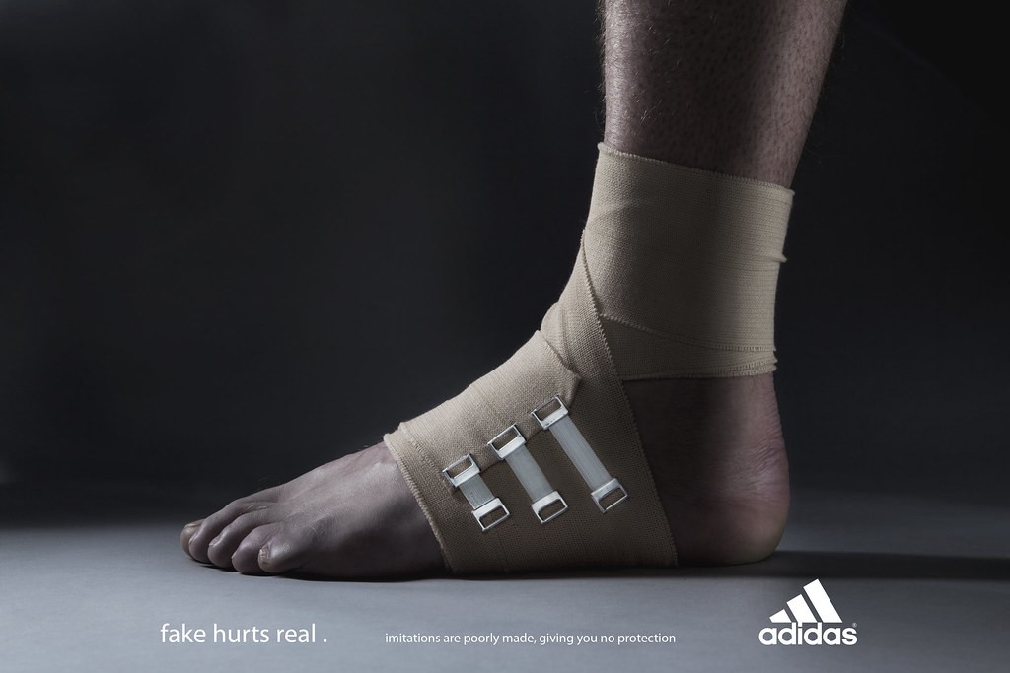



Market Scenario
About Hades
Environment Analysis
Revenue Streams
Potential Threats
Potential Threats
How
Mitigation Strategy
Increase in new players in the bicycle segment with offerings at various price points meeting various purposes of the consumers. Competitors tweak price points with features and use omni channel strategies to reach out to consumers
Using a differentiation focus strategy to push products to the retail markets with campaigns being more pronounced about the specific benefits and features of the product
MARKET COMPETITION
A visual storytelling campaign which narrates how the actual products have the expected benefits
Mergers & Acquisitions of various organizations to maintain the leadership position, might lead to cannibalization of its own existing mass market, impacting sales of the most profitable products
Launching different product segments depending on their primary purpose and the benefits served, and pricing at the sweet spot to stay ahead of the competition
CANNIBALIZATION
While certain initiatives have been taken by the central and the state government to encourage faster adoption of electric mobility, e-bicycle segment has been excluded from to major initiatives which it has introduces FAME-II and PLI scheme
Collaborations with state and central government on MoUs to develop safe cycling infrastructure to reduce dependence on fossil fuels and meet clean energy commitments
VOLATILE BUSINESS ENVIRONMENT
Cycling events held in Kolkata
While the disposable income of individuals have increased, prices of regular commodities have increased, due to increase in price of raw materials or production-related factors
Due to increase in input cost, price of end products have also increase substantially. This can be mitigated to a certain extent through strategic procurement, forecasting demand and slabs on sales targets to be achieved
INFLATION RELATED ISSUES

Slide 10
THANK YOU

